Slide 1
Navigation and 3D Mapping with ROS2
Software Architectures for Robotics (A.Y. 2021/22)
Michele Pestarino ()
Federico Sacco ()
Thomas Campagnolo (5343274)

Slide 2
UML – Unified Modelling Language

Slide 3
UML – Unified Modelling Language
Diagrammi UML
Nota a piè di pagina

Slide 4
Navigation2

Slide 5
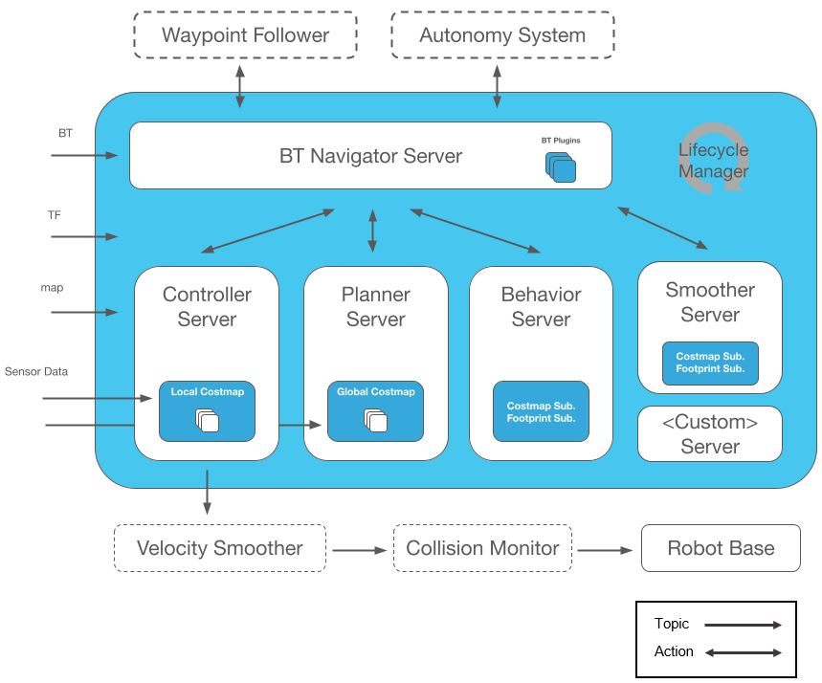
Navigation2 - Overview
Autonomous mobile robot navigation framework
Behavior Tree-based navigation
Independent Modular Servers
Multiple local trajectory and path planners
Sensors processing for collision avoidance
Recovery behaviors
Positioning system
Runtime lifecycle manager
Plugins
https://navigation.ros.org/index.html

Slide 6
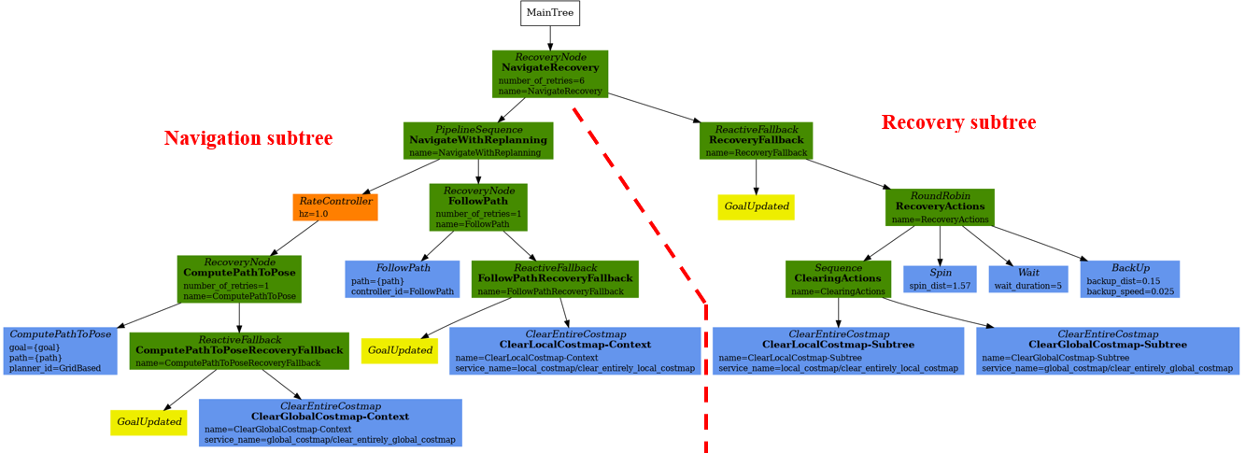
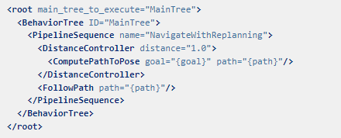
Navigation2 – Behavoir Trees (BT) Navigation
Why BT?
Tree-based execution model and task planner
Set many different plugins types
Model complex tasks
Using BT
CPP library
Specific Nodes: Action, Condition, Decorator, Control
Custom nodes to extend or change behavior
Navigate to pose
Navigate through poses and pause near goal-obstacle
Navigate and replan multiple path and trajectory
Follow dynamic object
Odometry calibration
Example BT: Navigate to Pose with Replanning and Recovery
Behavior trees XML file
BT node call task server in other processes
Navigation subtree, Recovery subtree
https://navigation.ros.org/index.html

Slide 7
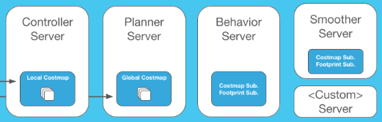
Navigation2 – Modular
Indipendent Servers and Plugins
Map Server, load, serve, and store maps;
AMCL, localize the robot on the map;
Nav2 Planner, plan a path from A to B around obstacles;
Nav2 Controller, control the robot as it follows the path;
Nav2 Smoother, smooth path plans to be more continuous and feasible;
Nav2 Costmap 2D, convert sensor data into a costmap representation of the world;
Nav2 Recoveries, compute recovery behaviors in case of failure;
Nav2 Core, plugins to enable your own custom algorithms and behaviors;
…
https://navigation.ros.org/index.html

Slide 8
Spatio-Temporal Voxel Layer (STVL)

Slide 9
STVL - Overview
Navigation2 Plugin
Costmap Layer
Developed and maintained by Steven Macenski at Simbe Robotics
OpenVDB, open-source C++ library built by Dreamworks “comprising a novel hierarchical data structure and a suite of tools for the efficient storage and manipulation of sparse volumetric data discretized on three-dimensional grids...”
Tasks
- Replacement for the standard voxel representation of the environment
- Ability to efficiently maintains temporal 3D sparse volumetric voxel grid with decay through sensor models
- Wrapped with ROS tools and interfaces to the navigation stack for uses in standard ROS configurations
- Possible without ROS/Navigation
https://github.com/SteveMacenski/spatio_temporal_voxel_layer/

Slide 10
Why STVL?
Spatio-
- representation of the environment in a configurable “voxel_size” voxel grid
- possibility of executing an approximate voxel grid filter for buffered measurements, which can be parameterized at
runtime in the configuration yamls
- reduction of spikes in the “move_base” cpu due to dense measurement readings when approaching objects
(i.e. more points)
- slightly increase overheads (1-2%) for nominal operations
-Temporal
- novel concept of “voxel_decay” with configurable functions that expire voxels and their occupation over time
- store times in each voxel after which the voxel will disappear from the map
- the time it takes to clear depends on the configured functions and acceleration factors
- voxel acceleration uses given FOV to compute the frustum geometry:
Depth cameras (e.g. Intel Realsense) are modeled with traditional 6-planed cubical frustums
3D lidars (e.g. Velodyne VLP 16) are modeled with their hourglass-shaped FOV.
https://github.com/SteveMacenski/spatio_temporal_voxel_layer/

Slide 11
Why STVL?
Local Costmap
- use of the information coming from the robot before the decay time for the local cost map
- configuration of a short decay time of the voxels in order to plan only in relative space
- operate with more information than other times when the speed is faster or slower
- decay time 5-15 seconds nominally good
Global Costmap
- time of 15-45 seconds due to things moving in the scene (e.g. shop, warehouse, construction zone, office, etc.)
- possibility of not decaying the voxels in the global map
permanent voxels set decay to -1 (not recommended for planar lidars)
Mapping
- map an environment in 3D in real-time
mapping mode will maintain the entire voxel grid and save the map using the services provided (maps may be visualized using vdb_viewer)
- run multiple instances of the layer one to map and other to navigate
https://github.com/SteveMacenski/spatio_temporal_voxel_layer/

Slide 12
Linorobot2

Slide 13
Linorobot2 Simulation - Overview
Description
Navigation and mapping with ROS 2 using the Nav2 package for robot navigation and the Spatio-Temporal Voxel Layer (STVL) plugin for mapping the explored environment in 3D.
Task
Test and explore the capabilities of this 3D mapping plugin with multiple map layouts.
Link alla nostra github repository

Slide 14
Linorobot2 Simulation - Overview
Metterci qualche screen di linorobot all’interno dei diversi ambienti? (oppure inserirle nella slide precedente)
Didascalia delle immagini

Slide 15
Linorobot2 Simulation – Office Environment
3D LiDAR Sensor
RGB-D Sensor
VIDEO RVIZ
VIDEO RVIZ

Slide 16
Linorobot2 Simulation – Office Environment
3D LiDAR Sensor
RGB-D Sensor
Breve descrizione dei topic, dimensione voxel ecc….
Analizzare le differenze
Breve descrizione dei topic, dimensione voxel ecc….
Analizzare le differenze

Slide 17
Linorobot2 Simulation – Playground Environment
3D LiDAR Sensor
RGB-D Sensor
VIDEO RVIZ
VIDEO RVIZ

Slide 18
Linorobot2 Simulation – Playground Environment
3D LiDAR Sensor
RGB-D Sensor
Breve descrizione dei topic, dimensione voxel ecc….
Analizzare le differenze
Breve descrizione dei topic, dimensione voxel ecc….
Analizzare le differenze

Slide 19
Linorobot2 Simulation – 3D LiDAR vs RGB-D
3D LiDAR Sensor
RGB-D Sensor
PRO / CONTRO
PRO / CONTRO

Slide 20
What’s Next?

Slide 21
What’s Next?
Implementazione su altri tipi di robot

Slide 22
Repository, Documentation and Issue
Tutti i link delle repository, documentazioni ecc… (nostra repo, nav2, STVL, …)

